Slide 1
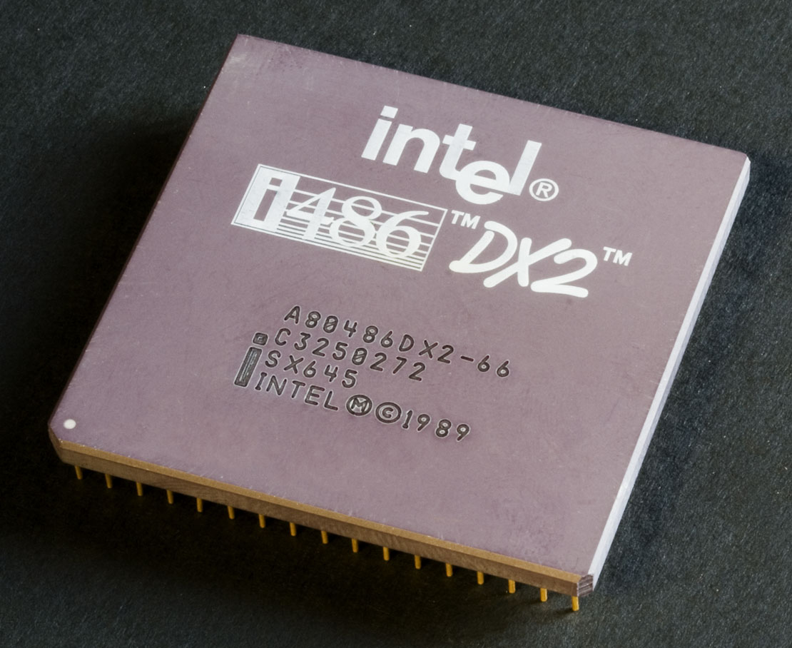
The Intel 486. Notice the white dot on the lower left corner.

Slide 2
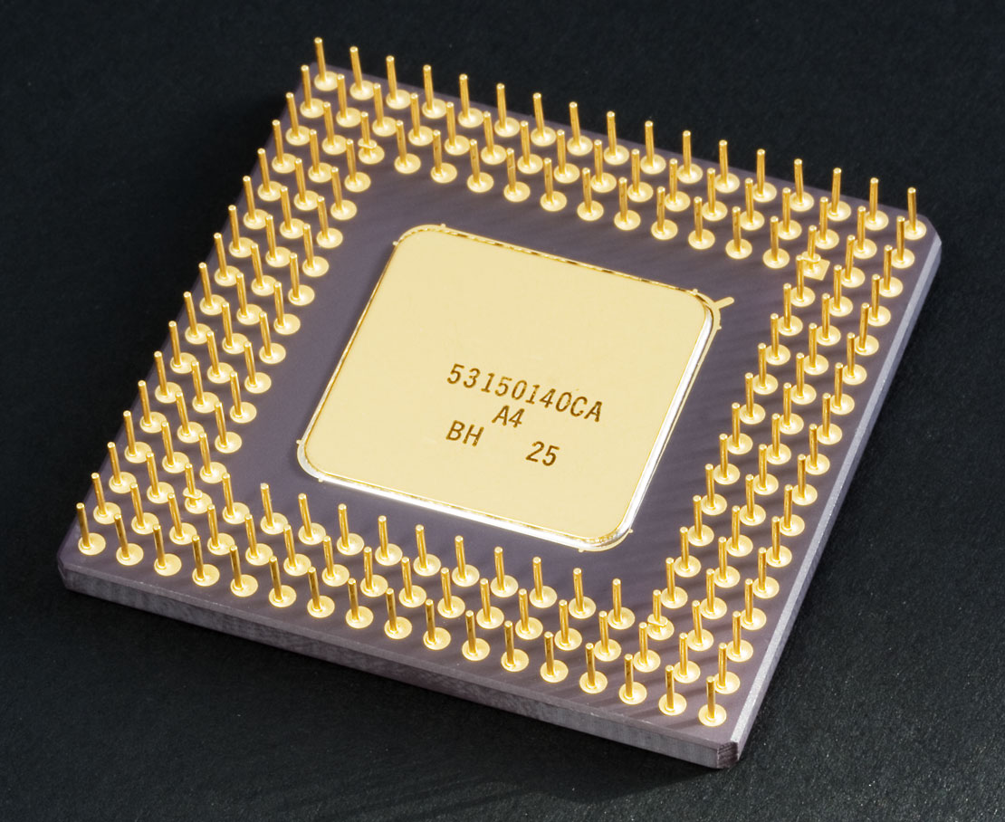
The bottom of Intel 486. Notice how big the pins are and that there is no “missing” pins thus making installation into the socket not idiot proof.

Slide 3
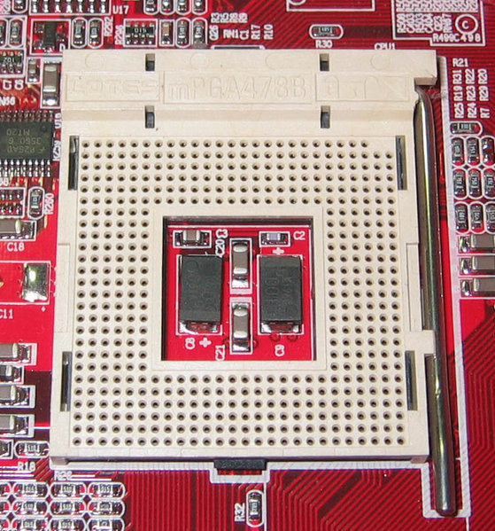
A socket 478 which was the first Pentium 4 socket. Notice the triangle to the top right but also the two “missing holes”. It had a rather simple locking arm to the right, a ZIF socket.

Slide 4
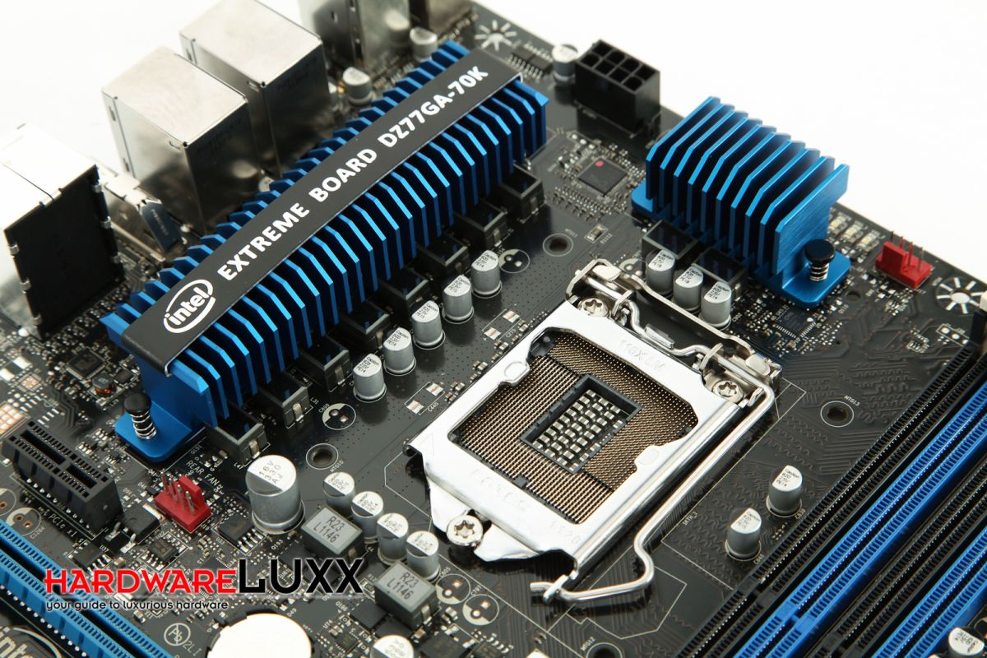
A socket 115x. Notice the rather intricate yet easy to use locking system, a ZIF socket. Also notice the protruding pieces that will sit inside the notches of the processor.

Slide 5
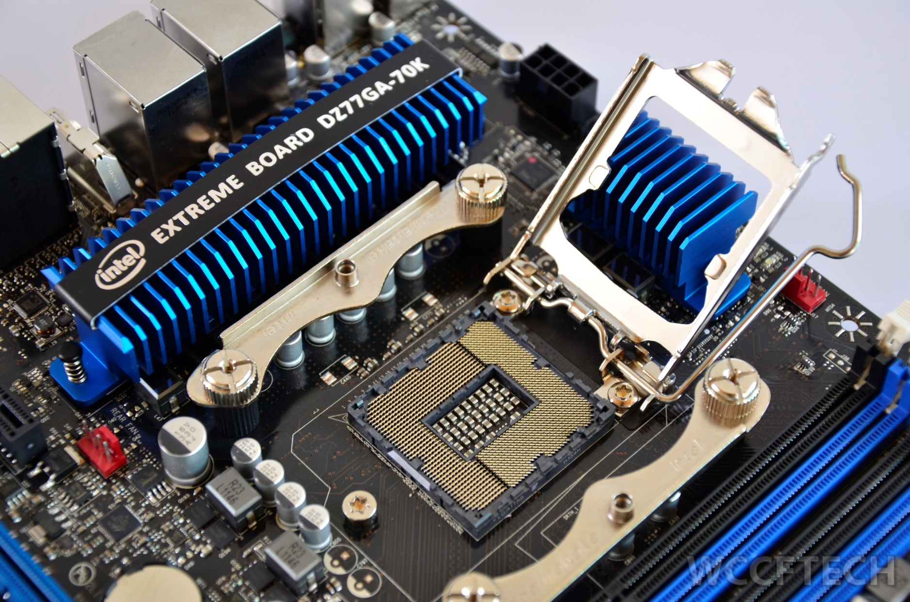
A socket 115x. There are no more holes as the pins stick up out of the socket to make contact with the landing pads on the processor’s LGA, a ZIF socket.

Slide 6
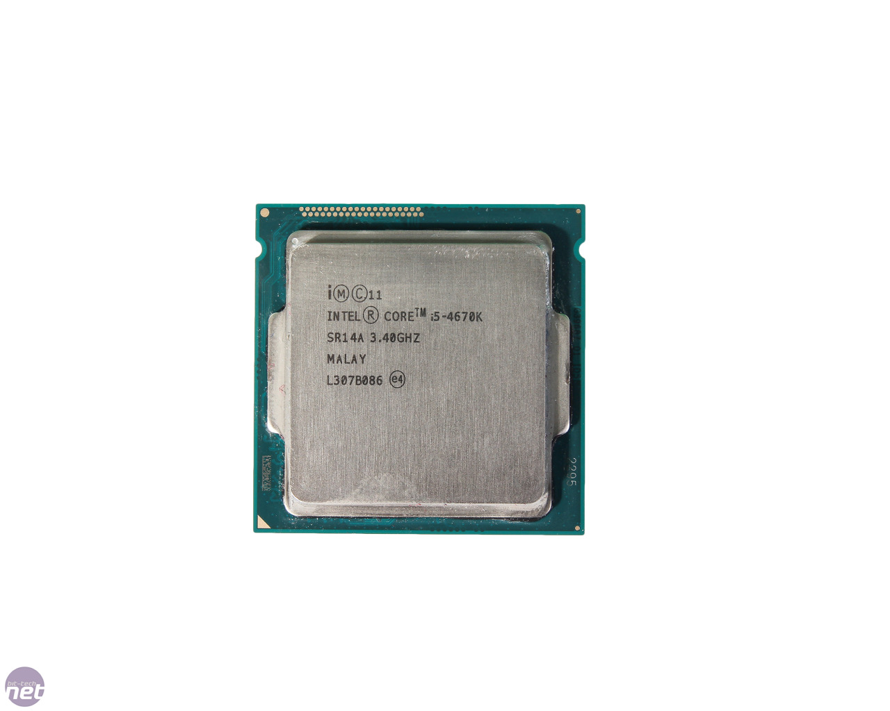
An Intel i5-4670K 4th generation processor. Notice the notches on the sides making installation into the socket idiot proof. Also notice the surface finish of the top upon where the heatsink will contact.

Slide 7
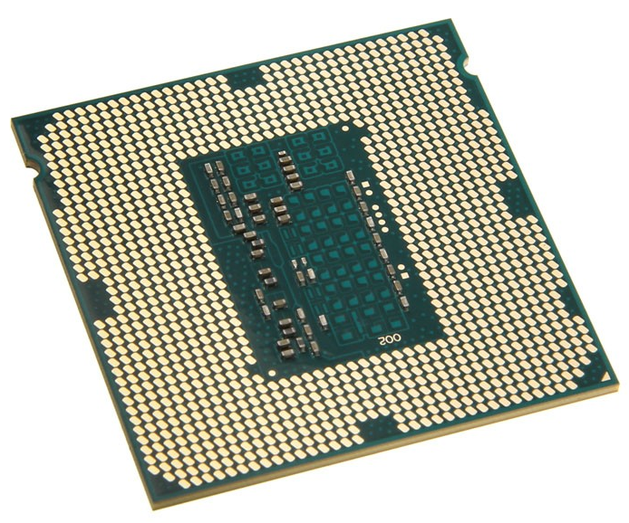
The LGA of an Intel i5-4670K 4th generation processor.

Slide 8
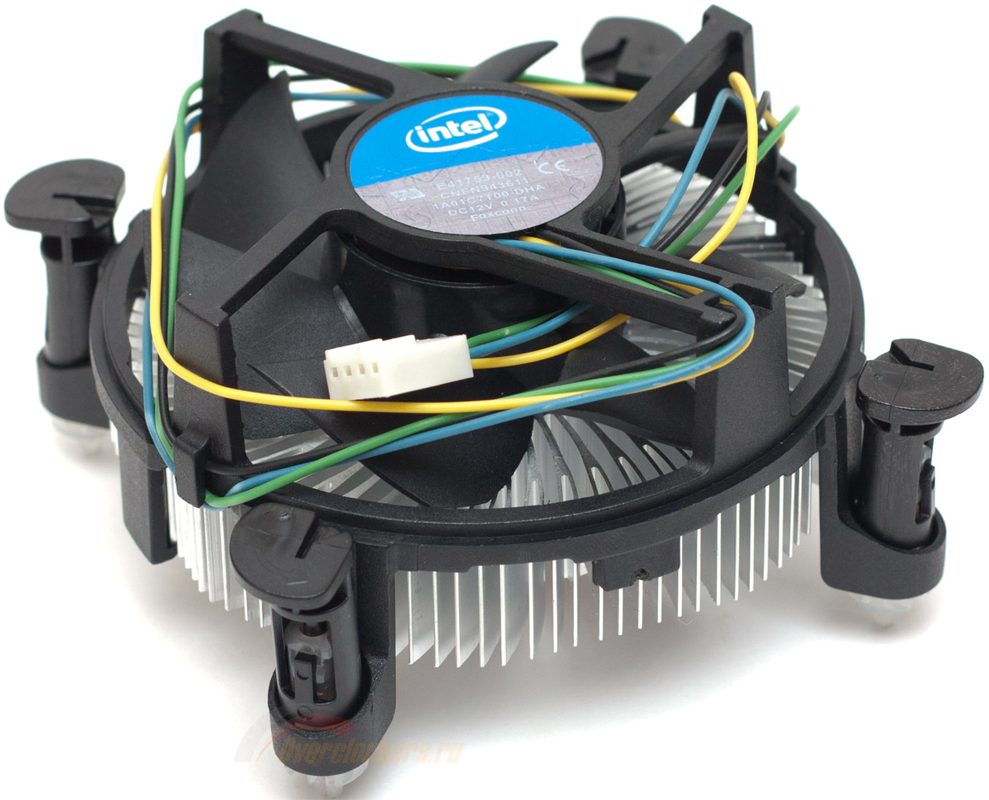
A stock boxed heatsink and fan for an Intel Processor.

Slide 9
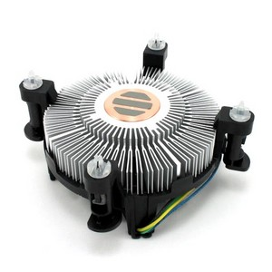
A stock boxed heatsink and fan for an Intel Processor showing preapplied TIM.

Slide 10
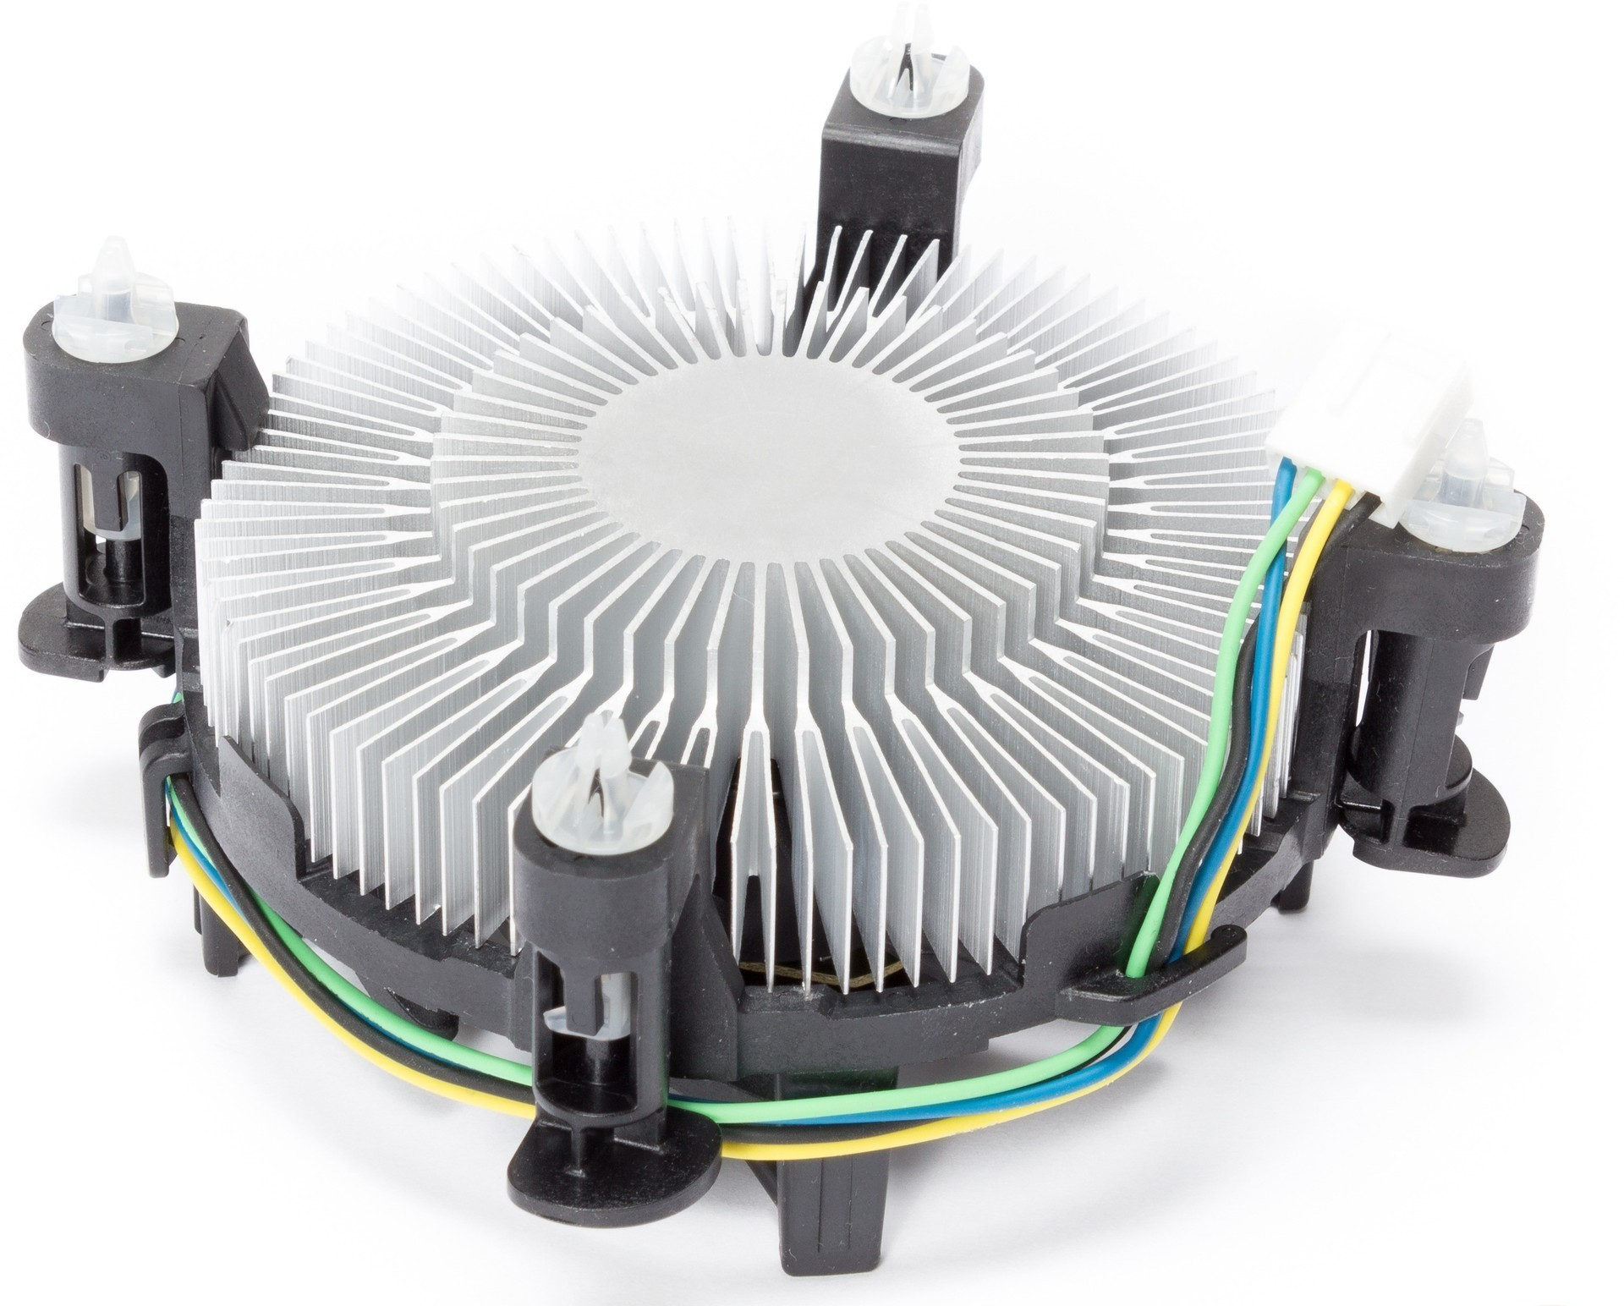
A stock boxed heatsink and fan for an Intel Processor illustrating the clips.

Slide 11
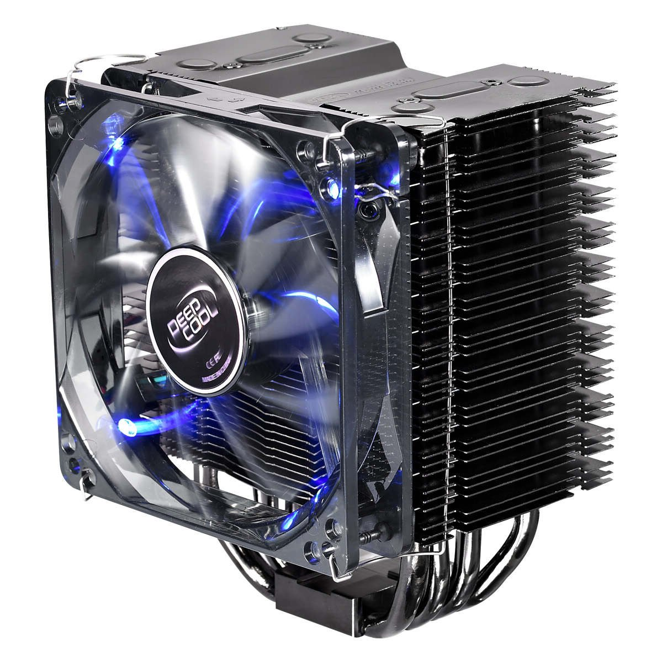
An enthusiast high end CPU cooler.

Slide 12
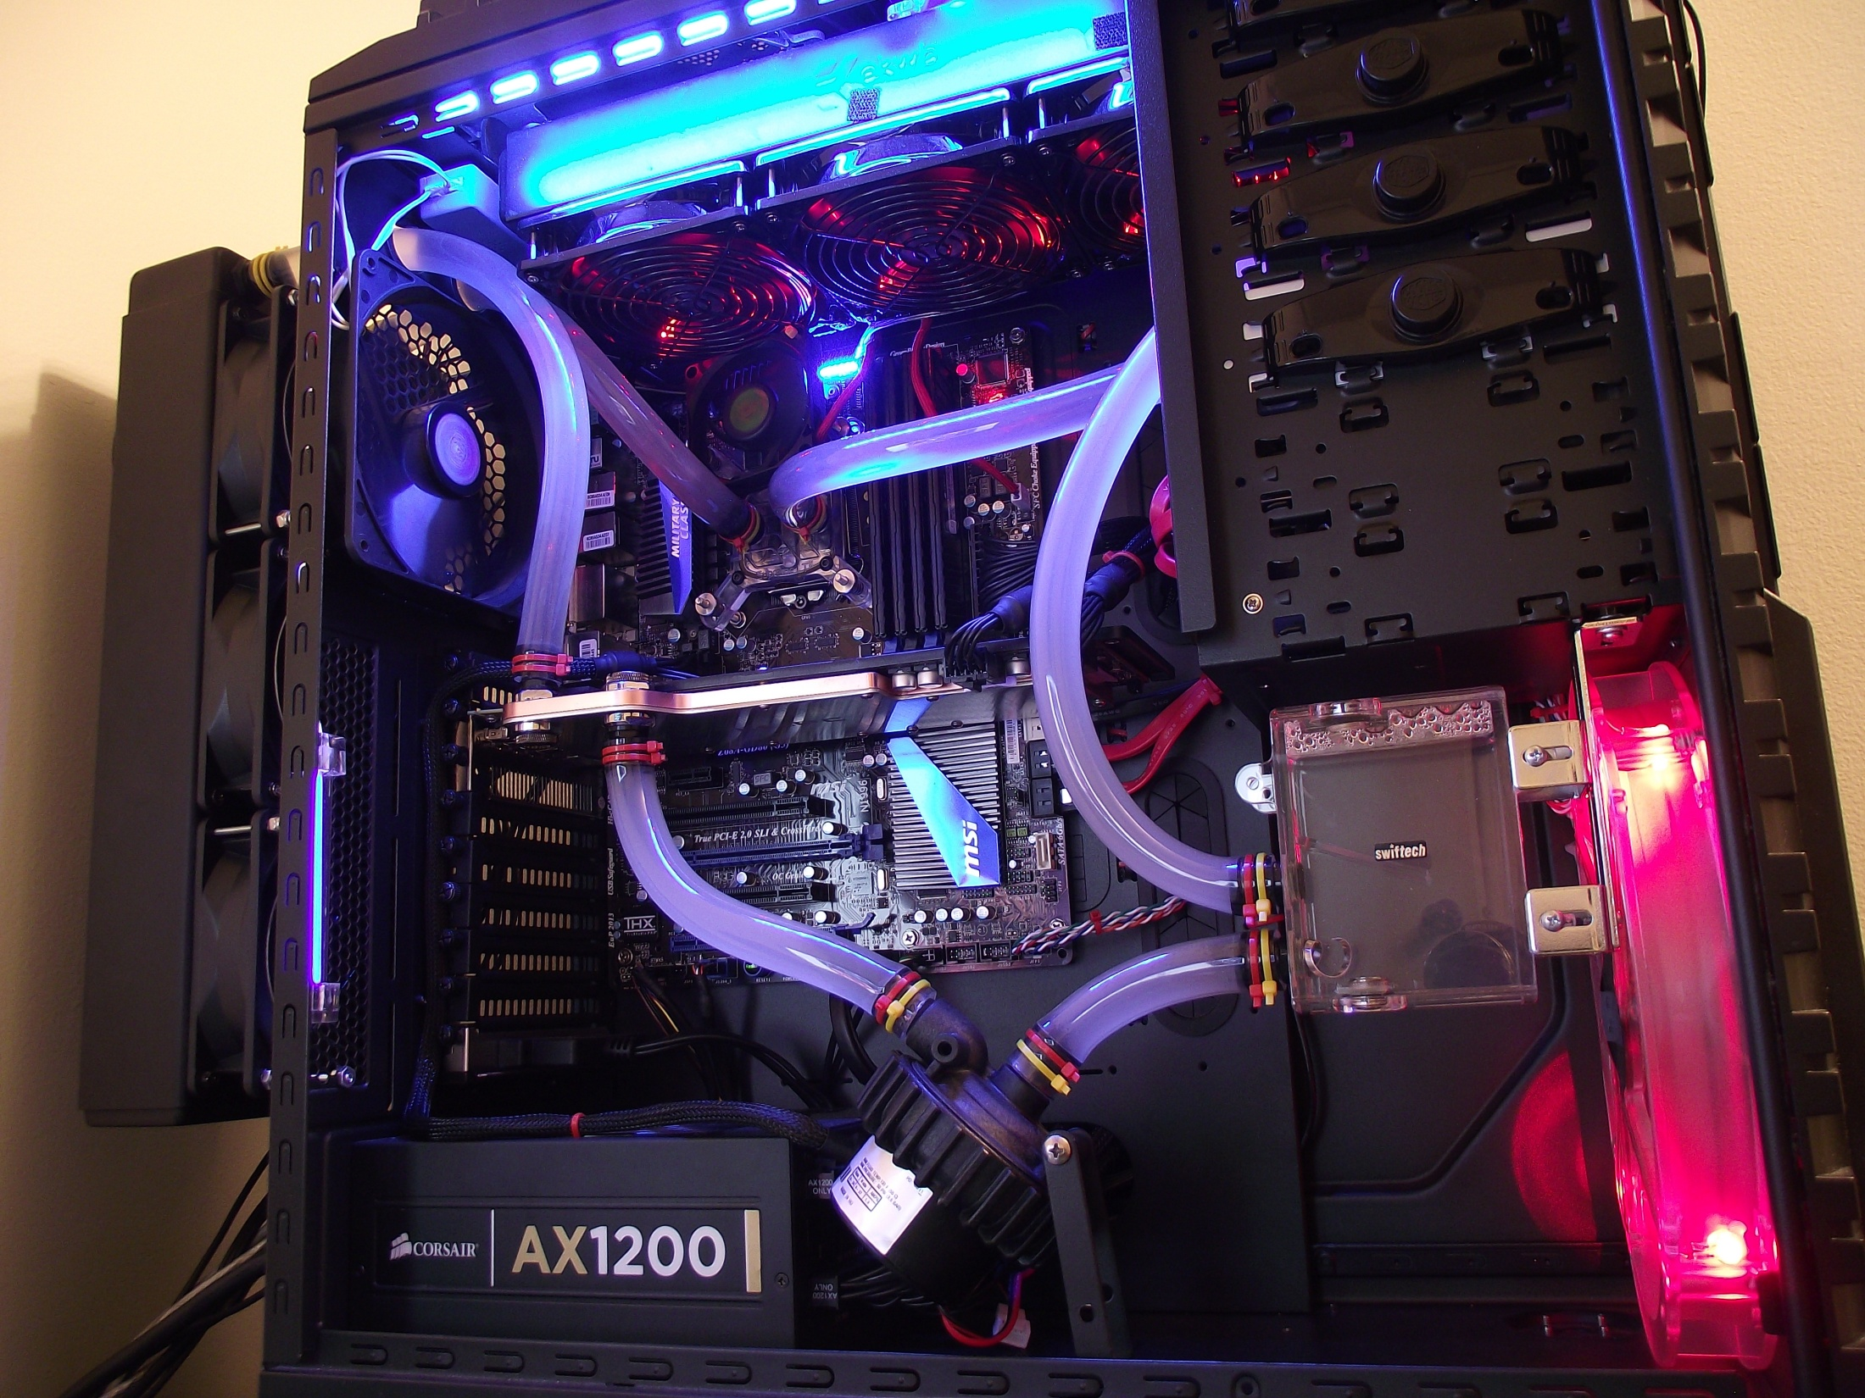
An enthusiast liquid cooling system.

